Slide 1
311 Call Center Tracking Data for the City of Los Angeles
DSO 545: Statistical Computing & Data Visualization
Group 4: Avery Rowe, Keqiang (Scott) Shi, Yang (Henry) Yu, Yunfan (Bill) Wang, Qianlian (Alisa) Xue
December 7, 2016

Slide 2
table of contents
problem
solution
analysis
insights
conclusion

Slide 3
In 2016, 2,000,000 service requests
came from calls.
60% of requests are calls
5.97 minutes per call
$766K per month
Source: MYLA311 (2016), Impact Learning (2010), Bureau of Labor Statistics (2016)
Notes:
Traditional call centers rely primarily on person-to-person transactions, such as calls and walk-in appointments. While these types of interactions are imperative for businesses like the city of Los Angeles, they are also the most costly ways of recording a request in terms of labor hours, wages, and fixed assets. According to the data provided by the city of Los Angeles, customers have the option to place service requests from 16 different sources (see Exhibit 1 for full list of request sources). In 2016, 60% of all service requests came from calls and only 18% came from digital channels.
Service Requests from Calls
According to the data provided by the city of Los Angeles, calls represented 60% of the total number of service requests in 2016 (MyLA311, 2016). Assuming that the average call time takes 5.97 minutes, the city of LA spends approximately 30,000 hours on calls per month and 355,000 each year (Carlaw, 2010). The time spent on calls represents $9 million in annual wages (Bureau of Labor Statistics, 2016) If even 10% of these calls result in customers receiving incomplete or inaccurate information, the impact to the city of Los Angeles is upwards of $900 thousand each year.
Service Requests from Digital Channels
In 2016, service requests from digital channels, such as the mobile app, Twitter, web forms, and email, accounted for approximately 18% of the total request volume. Mobile app requests represented the highest volume category of the digital channels, but only accounted for 14% of the total volume. A key challenge we identified is the issue of the MyLA311 mobile app’s position in the App Store. Currently, if a customer searches for “311” as an LA resident with location services on (so the software will know), the MyLA311 app occupies the third or fourth position, well below the fold, leading to a higher bounce rate of individuals already aware of and considering downloading the app (see Exhibit 2 for search results). Similarly, the search term “myla” returns the MyLA311 app as the second result, which is also below the fold. Furthermore, there is a conspicuous absence of any ratings or reviews.
Digital requests can be completed quickly and conveniently, regardless of schedule. Considering that 95% of Los Angeles residents are employed, it is probable that most of those 7.6 thousand people do not want to take extra time to visit or call and potentially wait on hold to resolve an issue (Bureau of Labor Statistics, 2016). Many businesses that are reliant on call centers

Slide 4

Increasing digital requests fuels the
multi-channel call center business model
Notes:
We believe there is a significant opportunity for the City of Los Angeles to improve its digital service offerings in order to increase the number of crowdsourced maintenance requests, increase the average handle time, and improve customer satisfaction. Digital requests from Twitter, web forms, email, and the mobile app can all be submitted conveniently and cost effectively through a customers’ smartphone, a device approximately 75% of all Los Angeles residents currently have and use (Nielsen, 2014). Digital requests can be completed quickly and conveniently, regardless of schedule. Considering that 95% of Los Angeles residents are employed, it is probable that most of those 7.6 thousand people do not want to take extra time to visit or call and potentially wait on hold to resolve an issue (Bureau of Labor Statistics, 2016).

Slide 5
methodology
3-tiered analytical approach:
Data exploration
Calls vs. Mobile Requests
Digital Deep Dive
Notes:
To better understand the call center tracking data, we examined overall volume of requests from 2016, and then analyzed the request channels sources and request types. We used statistical computing and data visualization techniques to explore and display the data and illuminate hidden insights. In terms of our methodology, we began by exploring the channel types, services, and daily frequency before comparing calls and mobile app requests, and ultimately examining historical digital channel performance.
The city of Los Angeles tasked Marshall students from the University of Southern California with analyzing its 311 call center tracking data, which includes records of over 3.5 million service requests from 2016. Our objective was to explore the datasets provided and determine inequalities in the distribution of service requests and services delivered. Group 4 analyzed the data using statistical computing and data visualization methods, such as bar charts, line graphs, regression analysis, and heat maps to return an optimal evaluation of key performance indicators to our client.
Bulky Items:
50% total requests
64% total call requests
46% total app requests
Graffiti Removal:
25% of total requests
4% of call requests
30% of app requests
Illegal Dumping Pickup

Slide 6
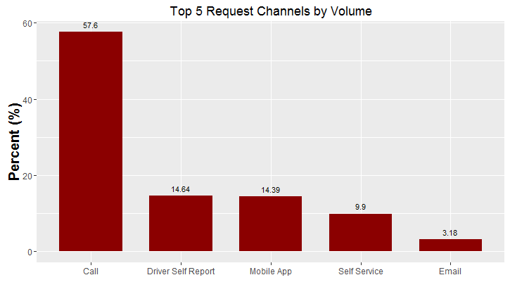
data exploration
Bar chart to visualize categorical variables
Calls represent 60% of total request volume
Mobile and email account for 18%
Notes:
First, we wanted to understand the channels through which customers can place service requests, so we looked at the five largest channels by volume. Since the request channels are categorical variables, we used a bar chart to visualize the data (see Figure 1).
From our analysis of the top 5 request channels by volume, it is clear that calls represent the largest proportion of the total request volume, followed by requests from driver self reports, mobile app, self service, and e-mail. The results of the analysis motivated our team to further delve into the types of services that drive these channels, but keeping focusing on the inequalities between call and mobile app requests.

Slide 7
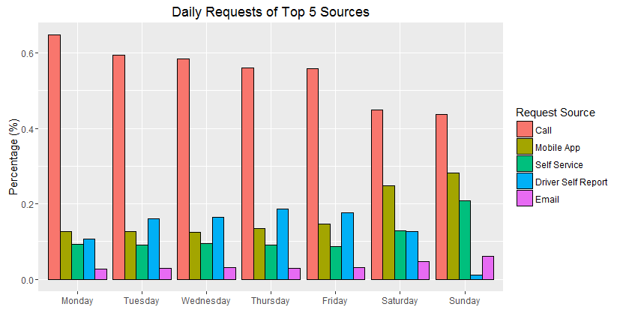
data exploration
Grouped bar graph to visualize distribution by day
Calls are most frequently used source each day
Mobile increases to 30% of total request volume on weekends
Source: MYLA311
Notes:
To better understand the distribution of requests by day, we created a bar graph to show the percentage of request sources by day (see Figure 3). Each day displays grouped bar graphs that correspond to a specific source according to color and volume of requests for that day.
In an analysis of the daily requests from the top five sources, calls are still clearly the most frequently utilized form of placing a service request for each of the seven days of the week. However, the change in the proportion of request sources per day changes drastically during the weekend. During the weekend, the proportion of 311 calls drop to 40% of total request volume, while that of mobile app requests increases to approximately 30%. Similarly, self service and driver self reports drop on Saturdays and Sundays, while email requests increase during this time.

Slide 8
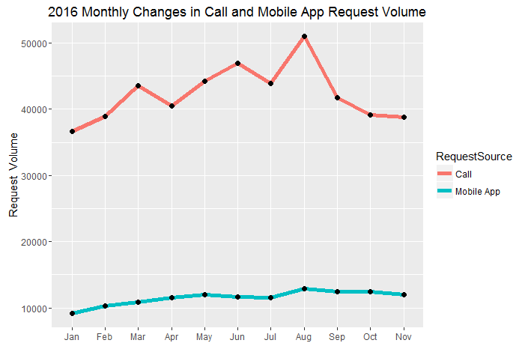
calls vs. mobile
Line graph to visualize distribution over time
Calls and mobile follow upward trend
Overall volume decreases due to seasonality
Notes:
After understanding the top performing service channels and most frequently reported service types, the team decided to take a deeper look at the top performing request source (calls) and the source of interest (mobile app). To visualize the volume of call and mobile app requests during 2016, we created a line graph to show the performance of these channels over time (see Figure 4).
From the graph, we can see that both calls and mobile app requests follow an overall upward trend, with a decline in requests from June through July and from October through the end of the year. The pattern of the overall graph reflects the seasonality of overall requests, implying Los Angeles residents are perhaps out of town or on vacation during these times and therefore cannot request or do not care to request.

Slide 9
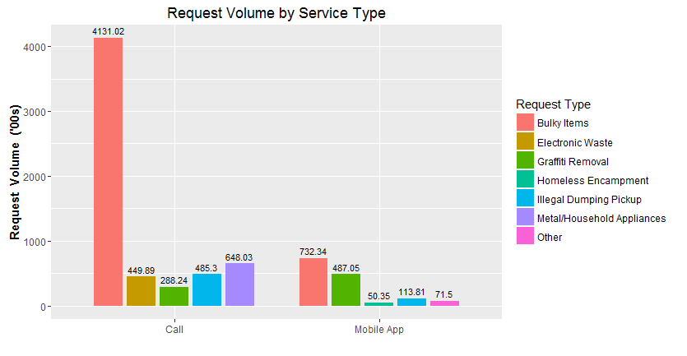
calls vs. mobile
Bar chart to compare distribution of services requested
Bulky items represent 25% of total requests
Graffiti removal requests from mobile are double the number from calls
Notes:
Looking further into the request volume via phone calls and the mobile app, we generated a histogram to compare the distribution of services requested for both channels (see Figure 5). The graph contains color coded bars to reflect the service type requested and plots the number of requests for each type.
According to the graph, bulky items represent the highest volume of requested service types—this finding is not surprising given that bulky items account for half of all requested service types across all methods of requesting a service. Graffiti removal is the second largest requested service type, accounting for 25% of total requests, and after removing the driver self reports, it is clear that this service is more frequently reported via the mobile app instead. In fact, mobile app requests of graffiti removal are nearly double that of call requests. The second highest ranking service type for calls is electronic waste removal, which is virtually unrepresented by mobile app requests.

Slide 10
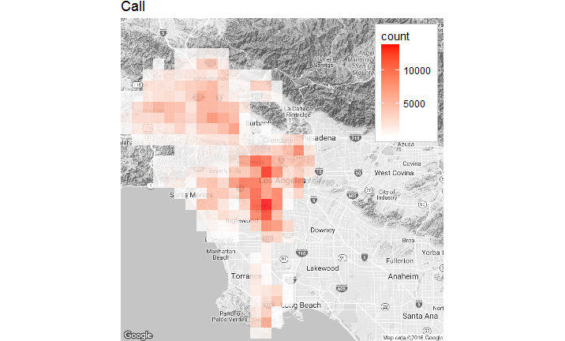
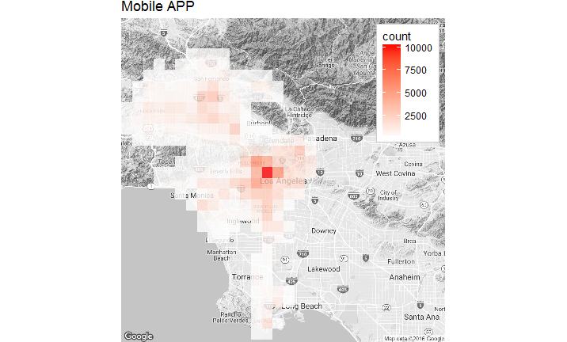
calls vs. mobile
Heatmaps to visualize geographical distribution
Highest frequency in DTLA
Call requests are more widely distributed
Notes:
In order to see the geographical distribution of service requests made through calls or the mobile app, we created heat maps for both request sources (see Figure 6). The graphs are plotted over a Google Map of Los Angeles County and display the relative frequency of requests by location, indicated by the strength of the tile color. The graphs are shown side-by-side for ease of comparison.
According to the graphs, both call and mobile app usage were highest in Northeast Los Angeles and in Downtown Los Angeles; however, call request volume is more widely distributed throughout the county, while mobile app requests centralize around Downtown Los Angeles. From the comparison, it is clear that mobile app is better received in Downtown Los Angeles as opposed to other areas throughout the county, as usage is highest, indicating a greater willingness to try the app. Since requests are infrequently placed through the mobile app in Northeast and Southwest Los Angeles, these locations represent an opportunity to target potential new users.

Slide 11
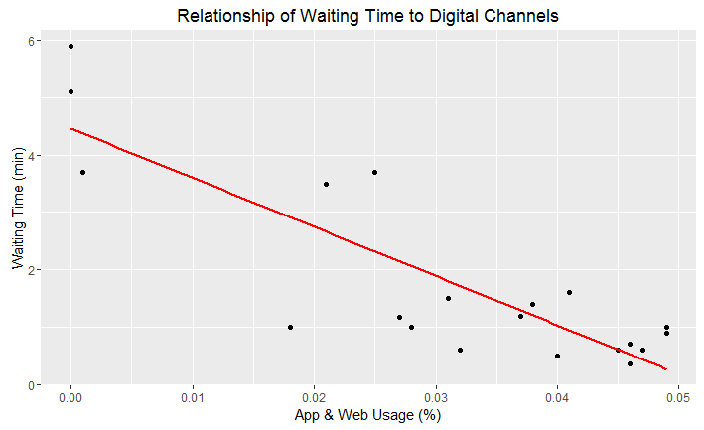
digital deep dive
Regression to test relationship between select digital channels and average wait time
Independent and response variables are highly correlated
As digital request volume increases, wait time decreases
Notes:
In order to further understand the potential of digital channels, we combined the request data from the mobile app and web form sources for analysis. To analyze the relationship between the rate of requests from the selected digital channels and the average customer wait time, we generated a simple regression model (see Figure 7). A simple regression models show the degree of correlation between the independent variable (in this case, the selected digital channels) and a response variables (in this case, the average waiting time).
According to the model, the independent and response variables are highly correlated, as evidenced by the multiple R-squared of 0.72. The relationship between the rate of requests from the digital channels and the waiting time explains 72% of all changes in waiting time. The negative sloping regression line illustrates the trend that as the rate of digital requests increase, the waiting time decreases. More specifically, a customer will have an average waiting time of under 50 seconds, if the rate of digital requests is 45% of total request volume. Therefore, in can be inferred that increasing the number of requests through digital channels can significantly improve key performance indicators, such as customer satisfaction and the city of Los Angeles’ average handle time.

Slide 12
Key Findings:
Calls currently account for majority of requests regardless of service type and time
Mobile requests for graffiti removal are double the number from calls
Mobile and call frequency are greatest in DTLA
As digital request volume increases, customer wait time decreases
Recommendations:
Increase awareness of MyLA311 mobile app in DTLA through media campaign in public spaces
Increase engagement of MyLA311 users by highlighting key functionality and improved customer satisfaction
Increase conversion of web form and Twitter requests through improved digital presence
Notes:
Calls represent 60% of total request volume
Mobile and email account for 18%
Calls are most frequently used source each day
Mobile increases to 30% of total request volume on weekends
Calls and mobile follow upward trend
Overall volume decreases due to seasonality
Bulky items represent 25% of total requests
Graffiti removal requests from mobile are double the number from calls
Highest frequency in DTLA
Call requests are more widely distributed
Independent and response variables are highly correlated
As digital request volume increases, wait time decreases

Slide 13
Thank you! Any questions?

